Slide 1
Upgrading Java
New Developer Features in Java 17 and 21
Victor Grazi
BNY – VP Developer Enablement

Slide 2
Main features
Java 17
Record Classes
Sealed Classes
Pattern Matching
Enhanced Switch Statements
Switch Expressions
Snippets in JavaDoc
Local Variable Type Inference
Java 21
Sequenced Collections and Maps
Pattern Matching for Switch
Unnamed variables
Virtual Threads
Preview Features
Unnamed classes
Unnamed variables
String Templates
Notes:
Record Classes (JEP 395)
Pattern Matching for instanceof (JEP 394)
Sealed Classes (JEP 409)

Slide 3
Record Classes
record Triangle(double base, double height) implements Shape {}
Automatically assigns
equals()
hashCode()
toString()
All getters (but not setters – all fields are final)
Replace Lombok Data classes for final fields
Notes:
Define Rectangle record
Javap the record to show it is a class
Let IntelliJ convert to a traditional class to compare
Print it out
Make 2 and show equals
Show a canonical constructor and show a square constructor
Define an area method
Show how non-static fields cannot be created
Create a static doubleGoldenRatio and a non-static createGoldenRectangle

Slide 4
Record Class caveats
Record class can’t extend a class (but can implement an interface)
Record classes are final – cannot be subclassed
Cannot have instance fields besides the declared ones
All fields are final

Slide 5
Record Classes can contain implementation
public record Rectangle(double height, double width) implements Shape{
4 5 public Rectangle(double height) { 6 this(height, height); 7 } 8 public double area() { 9 return height * width; 10 } 11 12 static double goldenRatio = (1+Math.sqrt(5))/2; 13 public Rectangle createGoldenRectangle() { 14 return new Rectangle(height, height*goldenRatio); 15 }
16 }
3
Notes:
Line 3 canonical constructor

Slide 6
Sealed classes
Sealed classes are used to restrict which classes can extend them.
They can be classes or interfaces but not enums (Enums are final).
sealed interface Shape permits Circle, Rectangle { } record Circle(double radius) implements Shape { } record Rectangle(double width, double height) implements Shape { } record Triangle(double width, double height) implements Shape { } // Compile error Shape shape = new Rectangle(5.0, 7.0); // No need for default case if all permitted types are covered
double area = switch (shape) { case Circle c -> Math.PI * c.radius * c.radius; case Rectangle r -> r.width * r.height; }; System.out.println("Area = " + area); }

Slide 7
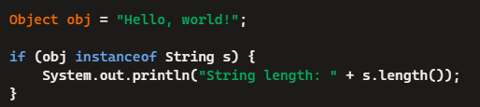
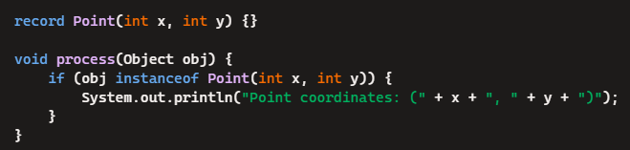
Pattern Matching
Combine conditional logic with type testing and extraction of values

Slide 8
Enhanced Switch
Enhanced Switch (assignment is internal)
// Area calculation using enhanced switch (Java 12+) public static double calculateArea (String shape, double param1, double param2) { double rval; switch (shape) { case "circle" -> rval = Math.PI * param1 * param1; // Circle area: πr² case "rectangle","square" -> rval = param1 * param2; // Rectangle area: width × height case "triangle" -> rval = 0.5 * param1 * param2; // Triangle area: ½ × base × height default -> throw new IllegalArgumentException("Invalid shape: " + shape); } return rval; }
Notes:
Display if statement
Then traditional switch
Then enhanced switch
Then switch expression
Then pattern switch expression
Then add yield
Then add println

Slide 9
switch expressions
Switch Expression (value is returned)
// Area calculation using switch expression (Java 14+) public static double calculateAreaSwitchExpression(String shape, double param1, double param2) { return switch (shape) { case "circle" -> Math.PI * param1 * param1; // Circle area: πr² case "rectangle","square" -> param1 * param2; // Rectangle area: width × height case "triangle" -> 0.5 * param1 * param2; // Triangle area: ½ × base × height default -> throw new IllegalArgumentException("Invalid shape: " + shape); }; }
Notes:
Display if statement
Then traditional switch
Then enhanced switch
Then switch expression
Then pattern switch expression
Then add yield
Then add println

Slide 10
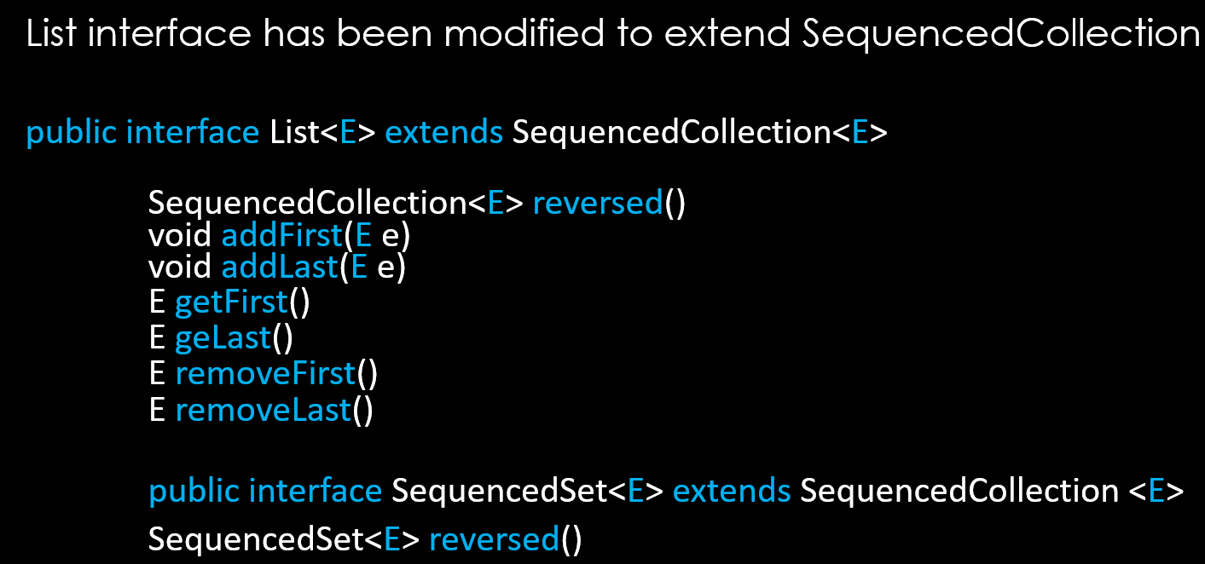
Sequenced Collection and SequencedSet

Slide 11
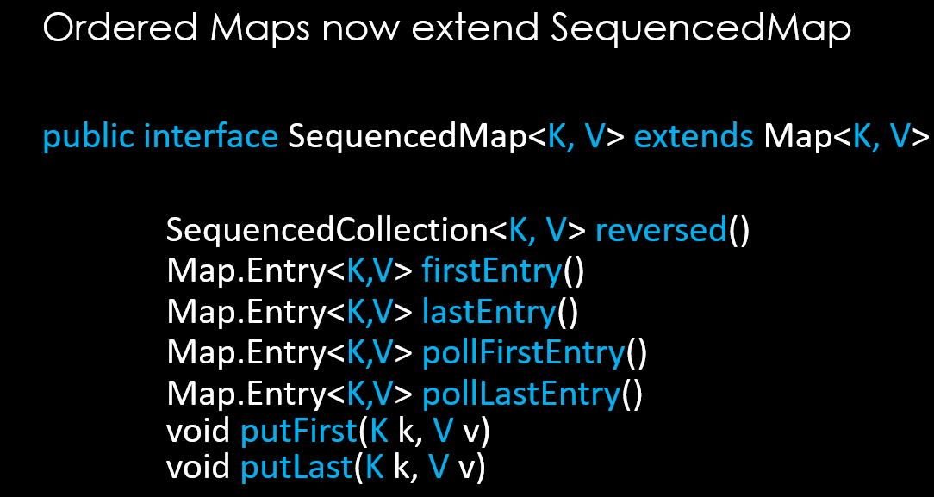
SequencedMaps

Slide 12
TextBlocks
String html = """ <!DOCTYPE html> <html> <head> <title>Sample Page</title> </head> <body> <h1>Hello, World!</h1> <p>This is a text block demo.</p> </body> </html> """;
Indents start from the first " in """
Trailing spaces are trimmed
Terminating """ can be on the same line as the last string line
Leading whitespace is trimmed by the closing """
(For literal instances of """ need to escape one ". Becomes \""" )
Notes:
Start with the old way
Ask AI to rewrite using text blocks4
Add white space
Show indents
Move last line """ to be right of opening, then to left of opening
Show how to escape literal instances of """

Slide 13
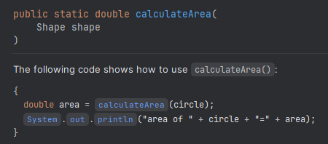
Snippets in JavaDoc
/** * The following code shows how to use {@code calculateArea()}: * {@snippet : * { * double area = calculateArea(circle); * System.out.println("area of " + circle + "=" + area); * } *} */ public static double calculateArea(Shape shape) { return switch (shape) { . . .
Produces JavaDoc

Slide 14
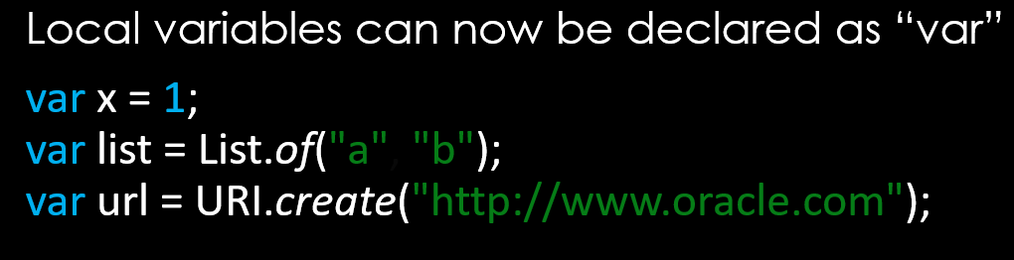
Local Variable Type Inference

Slide 15
Vector API incubator
In VM args --add-modules jdk.incubator.vector

Slide 16
Virtual Threads
Killer feature of Java 21

Slide 17

How Virtual Threads Work
Virtual threads are plain objects; have no more overhead than Strings or any other Java objects.
Thread scheduler:
Mounts virtual thread to a platform thread (aka “carrier thread”.)
Parks virtual thread and unmounts it from its carrier at blocking methods, so carrier can be reassigned to other virtual threads.
When blocking method completes or socket returns the bytes, virtual thread is mounted to a new carrier.
Most value is from:
I/O bound threads
sleep (but not wait) operations.

Slide 18
Virtual Thread Creation
Thread thread1 = Thread.startVirtualThread(() -> System.out.println("Running in a virtual thread")); Thread thread2 = Thread.ofVirtual().start(() -> System.out.println("Running in a virtual thread")); Thread thread3 = Thread.ofVirtual().unstarted(() -> System.out.println("Running in a virtual thread")); thread3.start(); try (ExecutorService executor = Executors.newVirtualThreadPerTaskExecutor()) { Future future = executor.submit(() -> System.out.println("Running in a virtual thread")); } try (var executor = Executors.newThreadPerTaskExecutor(Thread.ofVirtual().factory())) { Future future = executor.submit(() -> System.out.println("Running in a virtual thread")); }
Thread thread1 = Thread.startVirtualThread(() -> System.out.println("Running in a virtual thread")); Thread thread2 = Thread.ofVirtual().start(() -> System.out.println("Running in a virtual thread")); Thread thread3 = Thread.ofVirtual().unstarted(() -> System.out.println("Running in a virtual thread")); thread3.start(); try (ExecutorService executor = Executors.newVirtualThreadPerTaskExecutor()) { Future future = executor.submit(() -> System.out.println("Running in a virtual thread")); } try (var executor = Executors.newThreadPerTaskExecutor(Thread.ofVirtual().factory())) { Future future = executor.submit(() -> System.out.println("Running in a virtual thread")); }
Thread thread1 = Thread.startVirtualThread(() -> System.out.println("Running in a virtual thread")); Thread thread2 = Thread.ofVirtual().start(() -> System.out.println("Running in a virtual thread")); Thread thread3 = Thread.ofVirtual().unstarted(() -> System.out.println("Running in a virtual thread")); thread3.start(); try (ExecutorService executor = Executors.newVirtualThreadPerTaskExecutor()) { Future future = executor.submit(() -> System.out.println("Running in a virtual thread")); } try (var executor = Executors.newThreadPerTaskExecutor(Thread.ofVirtual().factory())) { Future future = executor.submit(() -> System.out.println("Running in a virtual thread")); }
Thread thread1 = Thread.startVirtualThread(() -> System.out.println("Running in a virtual thread")); Thread thread2 = Thread.ofVirtual().start(() -> System.out.println("Running in a virtual thread")); Thread thread3 = Thread.ofVirtual().unstarted(() -> System.out.println("Running in a virtual thread")); thread3.start(); try (ExecutorService executor = Executors.newVirtualThreadPerTaskExecutor()) { Future future = executor.submit(() -> System.out.println("Running in a virtual thread")); } try (var executor = Executors.newThreadPerTaskExecutor(Thread.ofVirtual().factory())) { Future future = executor.submit(() -> System.out.println("Running in a virtual thread")); }
Thread thread1 = Thread.startVirtualThread(() -> System.out.println("Running in a virtual thread")); Thread thread2 = Thread.ofVirtual().start(() -> System.out.println("Running in a virtual thread")); Thread thread3 = Thread.ofVirtual().unstarted(() -> System.out.println("Running in a virtual thread")); thread3.start(); try (ExecutorService executor = Executors.newVirtualThreadPerTaskExecutor()) { Future future = executor.submit(() -> System.out.println("Running in a virtual thread")); } try (var executor = Executors.newThreadPerTaskExecutor(Thread.ofVirtual().factory())) { Future future = executor.submit(() -> System.out.println("Running in a virtual thread")); }
Thread thread1 = Thread.startVirtualThread(() -> System.out.println("Running in a virtual thread")); Thread thread2 = Thread.ofVirtual().start(() -> System.out.println("Running in a virtual thread")); Thread thread3 = Thread.ofVirtual().unstarted(() -> System.out.println("Running in a virtual thread")); thread3.start(); try (ExecutorService executor = Executors.newVirtualThreadPerTaskExecutor()) { Future future = executor.submit(() -> System.out.println("Running in a virtual thread")); } try (var executor = Executors.newThreadPerTaskExecutor(Thread.ofVirtual().factory())) { Future future = executor.submit(() -> System.out.println("Running in a virtual thread")); }

Slide 19

Pinned Threads
Pinned threads - virtual threads that remain mounted to their carrier.
When a virtual thread enters a synchronized block, it will remain “pinned” to its carrier. (Even during I/O and sleep ☹)
Change all “synchronized” to use ReentrantLock.

Slide 20
Replace Synchronized with Lock
private int counter = 0; private final Lock lock = new ReentrantLock(); public void increment() { lock.lock(); // Acquiring the lock try { counter++; System.out.println("Counter: " + counter); } finally { lock.unlock(); // Releasing the lock } }
private int counter = 0;
public void increment() { synchronized (this) { // Synchronized block
counter++; System.out.println("Counter: " + counter); } }

Slide 21
Reconfiguring Spring Boot for Virtual Threads
Add the following property to your application.properties file:
spring.threads.virtual.enabled=true

Slide 22
Reconfiguring Tomcat for Virtual Threads
@Configuration public class AppServerConfig { @Bean public TomcatServletWebServerFactory tomcatFactory() { TomcatServletWebServerFactory factory = new TomcatServletWebServerFactory(); factory.addConnectorCustomizers(connector -> { if (connector.getProtocolHandler() instanceof AbstractHttp11Protocol<?> protocol) { protocol.setExecutor(java.util.concurrent.Executors.newVirtualThreadPerTaskExecutor()); } }); return factory; } }
<dependency> <groupId>org.apache.tomcat</groupId> <artifactId>tomcat-catalina</artifactId> <version>[version-number]</version> <!-- Use your Tomcat version --> </dependency>

Slide 23
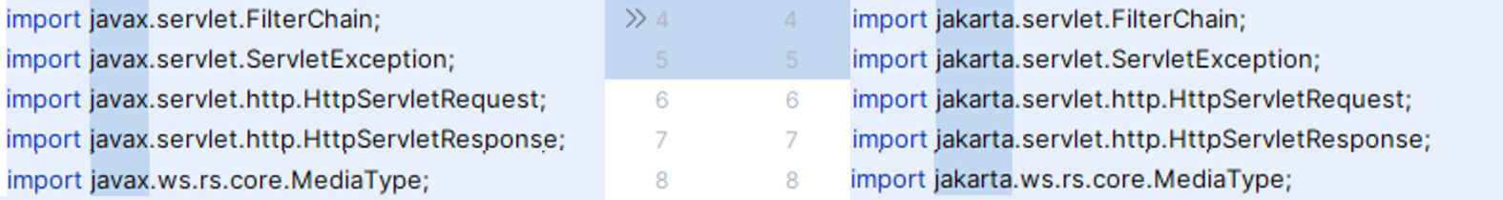


Migrating
javax to jakarta
Sleuth to Micrometer Tracing

Slide 24


